Slide 1
R.O.M
Room Occupancy Map

Slide 2
GOALS
PROBLEM
Estimate the occupancy of a building by counting people entering in its rooms
Reduce Economical Costs
There are many existing approaches to this problem:
Some are implementing expensive components
Other don’t reach a sufficient grade of accuracy
Our objective is to reduce the cost and reach the same high accuracy
Provide information regarding the building
in a quick and accessible way
This can be useful in a variety of ways, such as reducing the amount of time one has to spend in order to find a free room.
In our current time this could be used to monitor and enforce COVID-19 regulations

Slide 3
How to achieve this goals ?
We have designed different configurations and put them in comparison to see advantages and disadvantages
CONFIGURATIONS REQUIREMENT
The main requirement that is taken into account in comparing the different configurations is the accuracy

Slide 4
REQUIREMENTS
Physical placement
Mainly for safety reason, our system cannot be placed in such a way that it would ostracize the entrances.
Real time update
The system can be considered working only when it’s providing meaningful data.

Slide 5
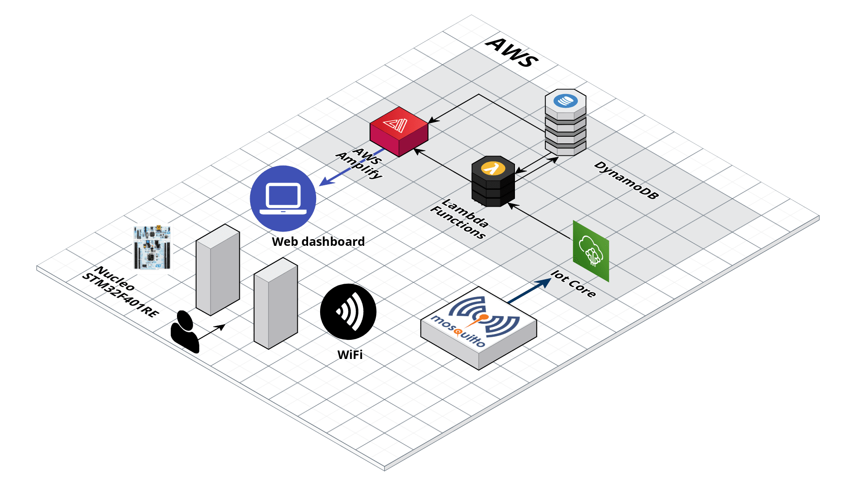
CLOUD NETWORK
The network structure of the system
The configurations are different for their physical placement but maintain the same network structure

Slide 6
CONFIGURATIONS
Let’s start with the core of our work

Slide 7
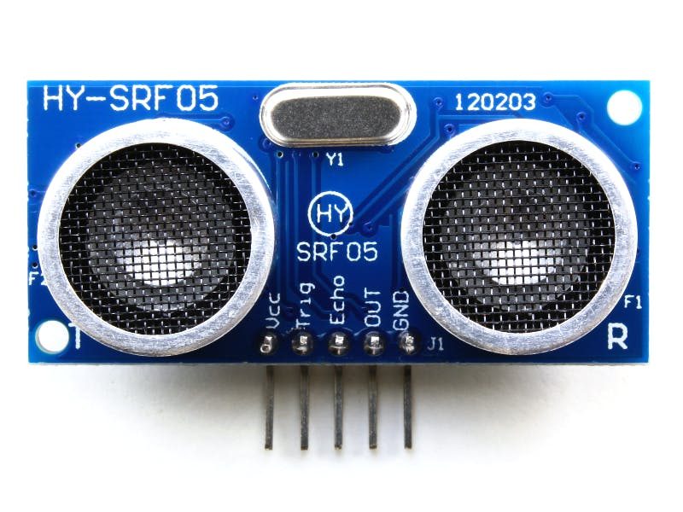
SENSORS UTILIZED
SRF05
Ultrasonic Sensor (x2)
Range: 1cm - 4mt
Angle: 30°

Slide 8
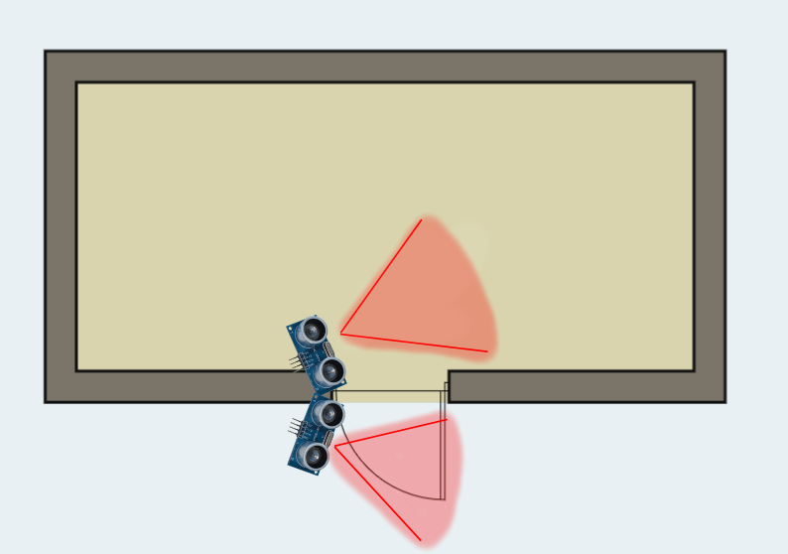
CONFIGURATION

Slide 9
ALGORITHM
Set initial flags Flag1 = 0 and Flag2 = 0;
Read the readings from both the Ultrasonic sensors and update the sequence Flag according to the trigger sequence of the sensors.
Flag1 == 1 and Flag 2 == 2 → Entry Motion;
Flag1 == 2 and Flag2 == 1 → Exit Motion;
Clear the flags to Flag1 = 0 and Flag2 = 0;
Wait 200 ms before next reading.

Slide 10
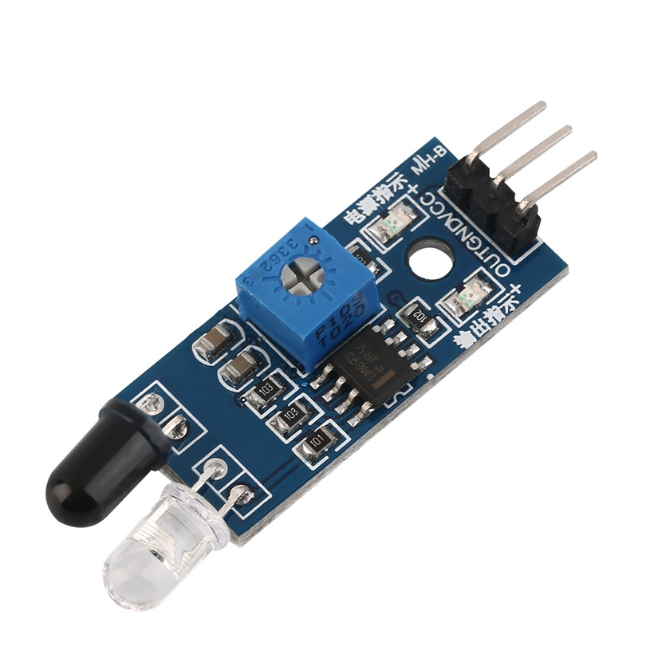
SENSORS UTILIZED
SRF05
Ultrasonic Sensor (x2)
Range: 1cm - 4mt
Angle: 30°
IR
Infrared Sensor (x2)
Range: 3 mt
Flexible sensibility

Slide 11
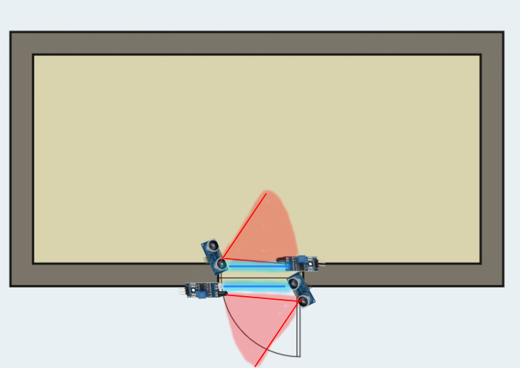
SECOND CONFIGURATION

Slide 12
ALGORITHM
Here we add two Infrared Sensors along with the Ultrasonic Sensors.
(Infrared sensors are used to increase the sensitivity of reading person walking in fast pace)
Set initial flags Flag1 = 0 and Flag2 = 0 for Ultrasonic Sensors and Flag3 = 0 and Flag4 = 0 for Infrared Sensors .
Read the readings from both the Ultrasonic sensors and both the Infrared sensors and update the sequence flag according to the trigger sequence of the sensors.
Flag1 == 1 and Flag 2 == 2 and Flag3 == 1 and Flag4 == 2;
Flag1 == 2 and Flag 2 == 1 and Flag3 == 2 and Flag4 == 1;
Clear the flags to Flag1 = 0 and Flag2 = 0 and Flag3 = 0 and Flag4 = 0;
Wait 200 ms before next reading.

Slide 13
CONFRONTATION
Evaluation, advantages and disadvantages
of our configurations

Slide 14
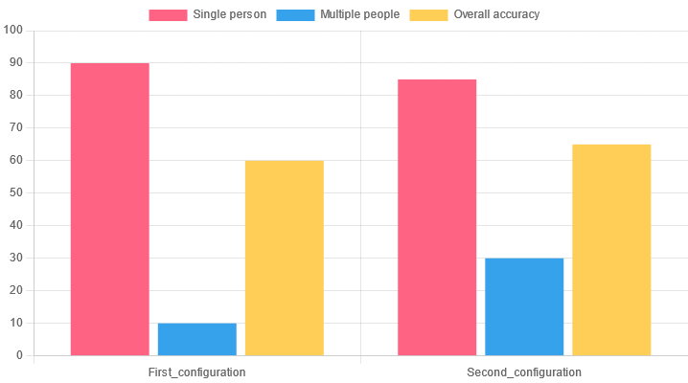
ACCURACY

Slide 15
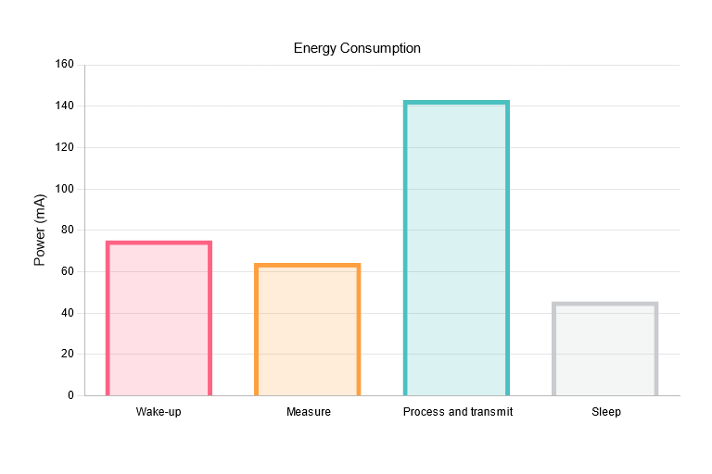
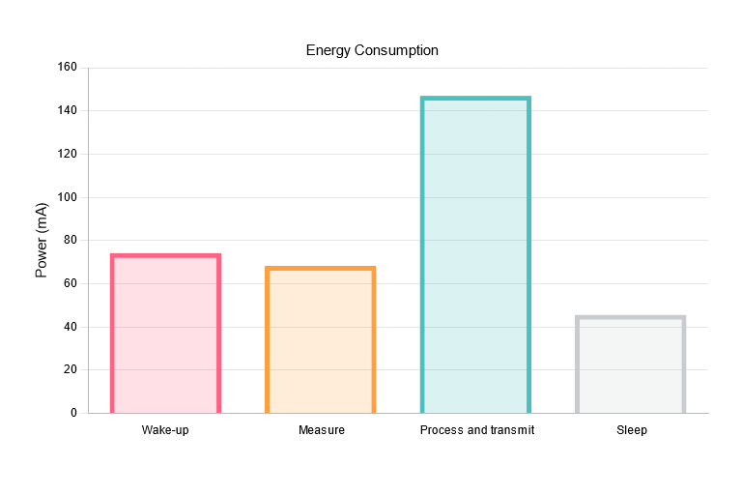
POWER CONSUMPTION
First configuration
Second configuration

Slide 16
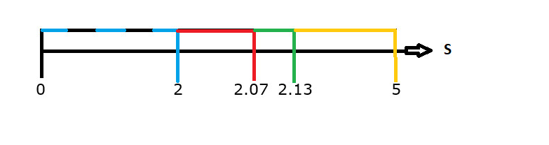
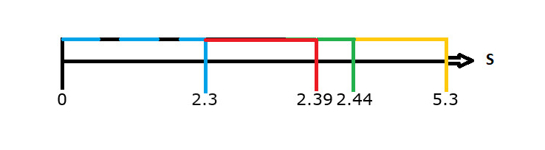
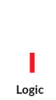
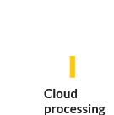
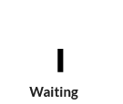


UPDATE TIME
First configuration
Second configuration
LEGEND
Measures
Logic
Sending

Slide 17
FUTURE UPDATES
What it’s still missing from the project
that keeps it from being complete

Slide 18
WHAT TO EXPECT
IMPLEMENT AND DOCUMENT A THIRD CONFIGURATION
As of now, a third configuration is in the work.
03
IMPLEMENT WIFI
As of now, the connectivity of our system relies on the native communication with the board. This has to be fixed as soon as possible
01
02
PROVIDE A FULLY FLEDGED DEMO
A video that encapsulates the totality of our project

Slide 19
Thanks!
Any questions?

